Slide 1
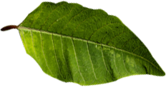
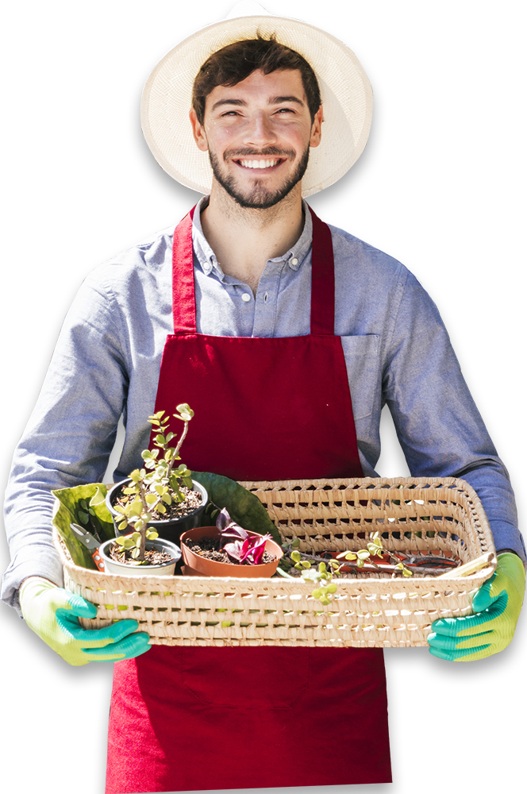

CAREFREE SMART FARMING SYSTEM (G13)
SUPERVISOR: Dr. Muhammad Khairi Faiz Bin Ahmad Hairuddin

Slide 2
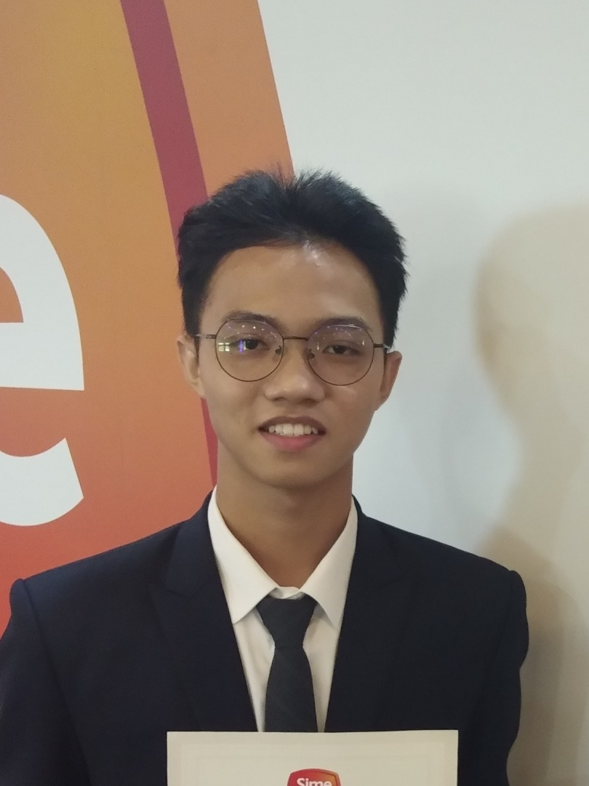
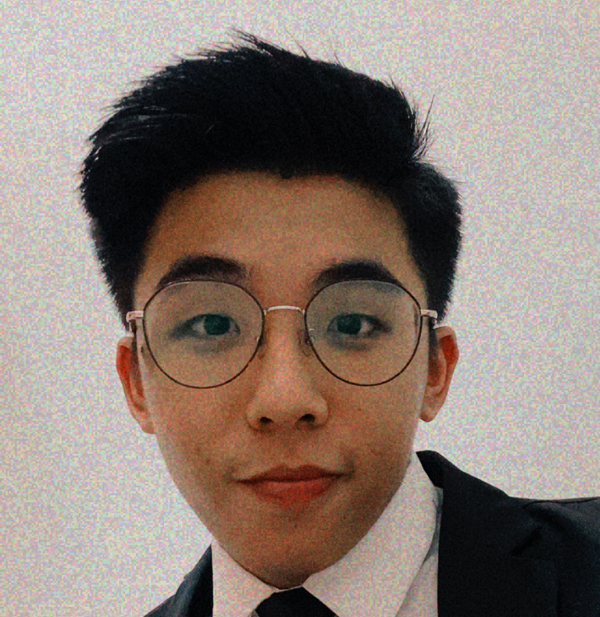
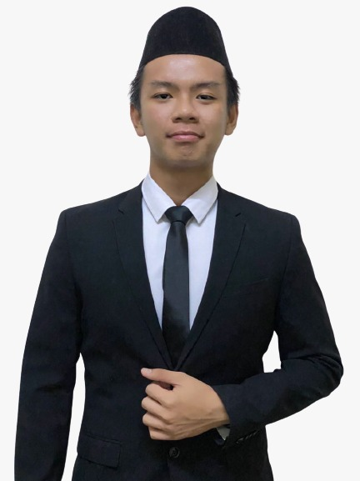
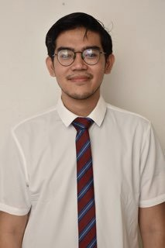
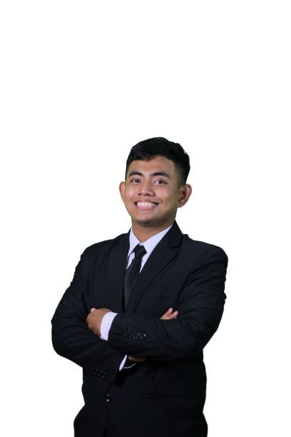
Meet Our Team
CHIA WEN HAN
Leader / Main Programmer
SOON WEE TECK
Treasurer
AHAMAD ADZAM PUTRA BIN AHAMAD
Project Narrator / Project Manager
MUHAMMAD FIKRI BIN MISNADI
3D CAD Designer
MUHAMMAD ZHARIF BIN MAD SHUKRI
@FAZLI
Prototype Constructor / Trouble Shooter

Slide 3
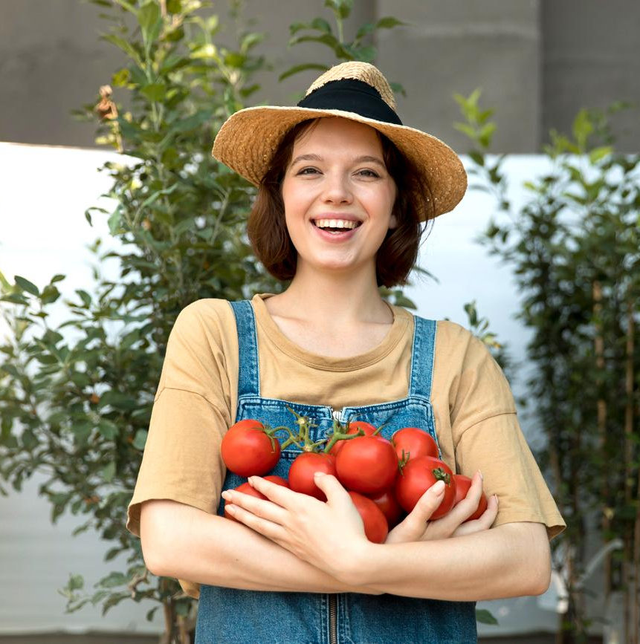
INTRODUCTION TO OUR PROJECT

Slide 4

CAREFREE SMART FARMING SYSTEM
Why Carefree?
- The user only needs to refill the fertilizer once a month
- The user only needs to refill the big water tank when it is out of water
Sensors used
Rain Sensor
Fertilizer Level Sensor
Temperature Sensor
Soil Moisture Sensor
Infrared Sensor Module
High-Frequency Bird Repeller

Slide 5
OUR FOCUS
Urban farming is the technique of producing, processing and distributing food in or around the urban settings. Urban farming involves cropping on the roofs of buildings or even indoors, and many urban farmers may lack professional farming skills.
Urban Farming

Slide 6
BENEFITS OF URBAN FARMING
01
02
03
FOOD SECURITY
EFFICIENT USE OF LAND
REDUCE CARBON FOOTPRINT
-Food security refers to having enough sustainable food to feed yourself and your family.
-Urban farmers can sell some of their harvest and keep the remainder.
-A viable option for maximizing the amount of land available to feed people.
-In example, Rooftop Garden, not only save space but also give an abundance of fresh vegetables.
-Reduce the carbon footprint of mass production and distribution.
- It aims to make healthy food more inexpensive and accessible to the general public.

Slide 7
EXISTING SOLUTIONS
IoT-based remote sensing
Computer Imaging
Agricultural drone
-Weather station is placed on the farms to observed and measure data.
Pros:
Easy to set up
Low Maintenance
Cons:
Difficult to detect if the sensors are malfunction
-Designed with image detection by using the camera sensors. The captured image will undergo digital image processing.
Pros:
Easy monitoring
Accurate result
Cons:
High Installation Cost
Image processing require a database
-Camera sensors are installed at the drone for imaging, mapping and survey. The measured data are crop health, irrigating, spraying and plant counting.
Pros:
Easy monitoring
GPS tracking system
Cons:
Less battery life around 40 to 30 minutes

Slide 8

BASED ON OUR SURVEY, THE CUSTOMERS’ BIGGEST CONCERNS ARE……

Slide 9
Statement from Customers
1.It is very difficult to ensure the plants to grow well.
2.They always forget or late to water their plants.
3. They believed that there are some of the waters wasted during watering plant process
4. They stated that they have experienced disturbance from the pests on their crops.
5. 53.3% of the interviewees have very little space for planting crops at their home.

Slide 10
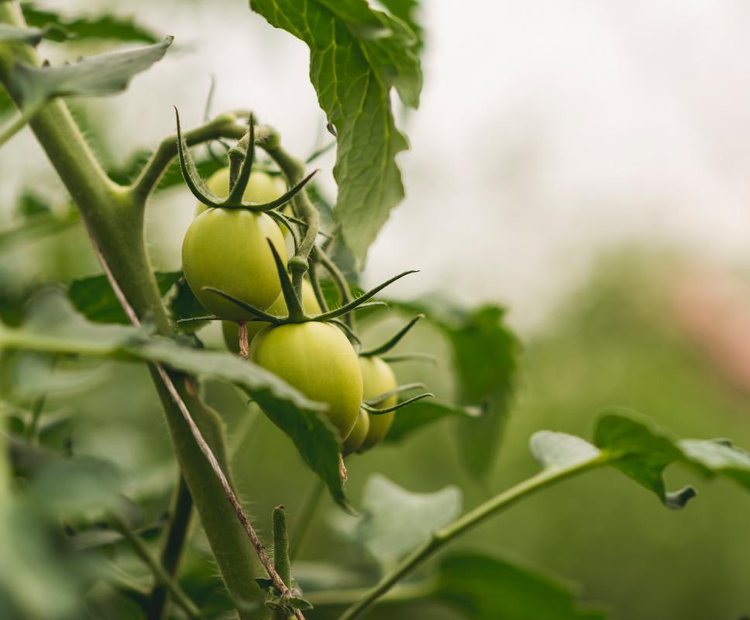
WHY OUR PRODUCT ?

Slide 11
FEATURES OF OUR PRODUCT
Smart monitoring mobile apps
-Blynk mobile apps will be installed on every customer’s smartphone
-show the soil humidity, fertilizer level and allow control to some features such as switching off the pest control feature at night.
2. Carefree and minimal maintenance
-only minimal maintenance which is refilling the fertilizer container once a month and replenishing the big water tank when it is out of water.

Slide 12
FEATURES OF OUR PRODUCT
3. Efficient water supply
Water only will be supplied to the soil by using a pump when the sensor detects the soil moisture less than 45%
4. High Frequency Bird/ Insect Sound Repeller
- When there is some motion or obstacle in front of the infrared sensor, the system will automatically emit the high frequency buzzer sound to get rid of the bird.

Slide 13
FEATURES OF OUR PRODUCT
5. Rain and temperature detection
-Rain and temperature sensor is installed at the system to detect parameter changes and notify the user through the mobile application.

Slide 14


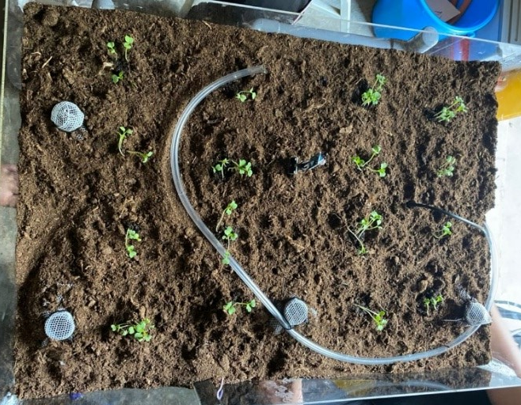




PRODUCT OVERVIEW
Cloud Service
Smart Farming System
Wi-Fi Module
Microcontroller and Sensors
Mobile Application
Actuator

Slide 15
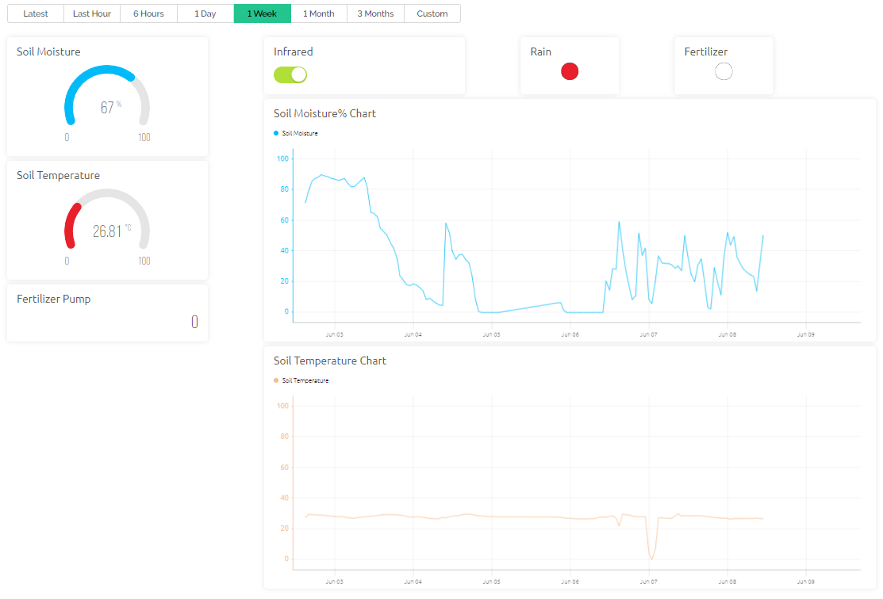
BLYNK USER INTERFACE (WEB DASHBOARD)

Slide 16
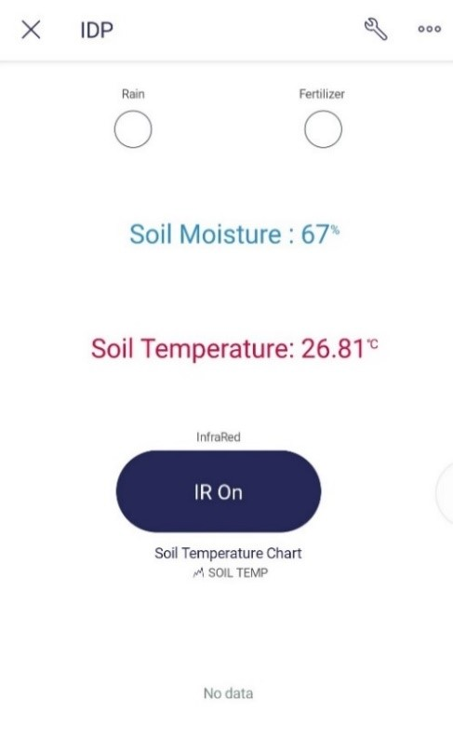
BLYNK USER INTERFACE (MOBILE DASHBOARD)

Slide 17

BUDGET AND COST
Part 1: List of bought component/material
-RM 462.33 due to cheap option and fast shipment
Part 2: List of existing component/material
-RM 62.15 are saved due to existing components/materials
Part 3: Actual cost of prototype
-RM 356.51 (RM105.82 less than total budget)

Slide 18
To justify the excessive cost……..
Latest prototype held in an acrylic container which is costly but in the real application, we use a cheaper material and more compact design.
We may not use some of the part that we buy such as the peat moss, Silicone sealant, plant tray, etc. if we implement this product in an open space.

Slide 19

CHALLENGES
Unstable Internet Connectivity
- The system must have stable internet connectivity so that we can proceed with fast transmission speeds.
Design of the system
Our team has changed some designs for our system and after several trials and errors, we came up with the final design which is the most suitable one that meets our goals.

Slide 20
FUTURE WORKS
Mobility of the product
- The product are quite difficult to move from place to place.
- By doing so, the product can be moved freely without experiencing any component failure.
Customization based on personal’s needs
The user can customize the type of electrical components used based on their needs and the type of crops.
By doing so, the system can work at its optimum level in a different environment without causing failure.

Slide 21
CONCLUSION
The user can reduce the time and effort needed as a better communication path for the transfer of important data between multiple nodes.
From our testing and results, the technology and materials we employed enabled us to create a cost-effective, efficient, and accurate product for farmers
As a result, we can infer that this prototype will undoubtedly assist small-scale farmers in efficiently monitoring their crops using a user-friendly app and other alarm mechanisms.

Slide 22
THANK YOU!
CAREFREE SMART FARMING SYSTEM

